Slide 1


Nitte Meenakshi Institute Of Technology
REMOTE MONITORING AND CONTROL OF GROUND STATION EQUIPMENTS ON SNMP
BY
J RAMYA
1NT08MCA17
Internal Guide External Guide
Dr. S.C.Desai Ms. S.Shantalakshmi
HOD, NMIT SCI./Engineer-SE.
Yelahanka Peenya
Bengaluru Bengaluru

Slide 2
MOTIVATION
Nitte Meenakshi Institute Of Technology
ISRO’s proposal for a monitoring and control system on SNMP
Our role to enhance the existing system
Thus contributing to the organization and the country
AIM
Remote monitoring and control support of given equipments on SNMP interface
Additional feature to the existing monitoring system
Easy configuration of new equipments in future (Scalable)
Maintain multiple clients and agents concurrently
Basis for communication link monitoring thus avoiding commercial Network Monitoring Systems

Slide 3
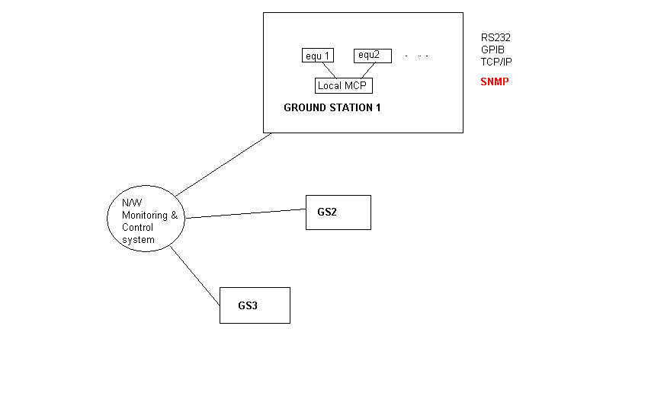
Nitte Meenakshi Institute Of Technology
GROUND STATION
Ground station- is a terrestrial terminal station designed for telecommunication with
satellites
It tracks and communicates with satellites that are in its line of sight (i.e. the satellite is
visible to the ground station)
OVERVIEW

Slide 4
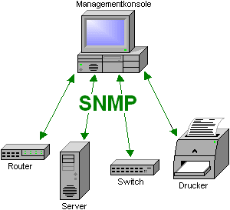
Nitte Meenakshi Institute Of Technology
SNMP - Simple Network Management Protocol
Internet-standard protocol for managing devices on IP networks
Common devices that typically support SNMP include routers, switches, Servers, workstations, printers
The key components are
Managed device- routers, switches, hosts
Manager (Network Management System)-
executes applications that monitor and control
managed devices
Agent- a software that runs in the managed device
that communicates with the manager

Slide 5
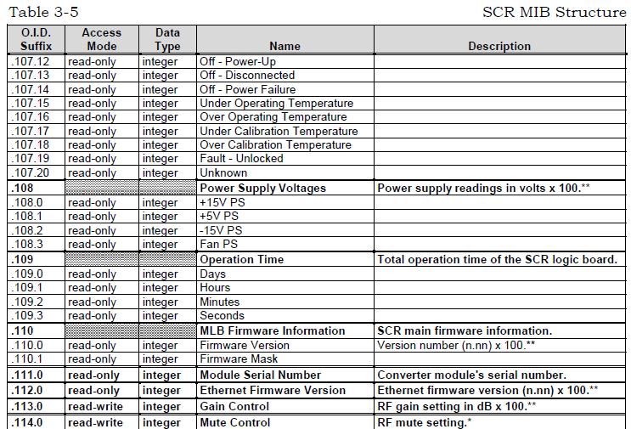
Nitte Meenakshi Institute Of Technology
MANAGEMENT INFORMATION BASE
The management variables are stored in a database called Management Information Base (MIB)
This database is present in the managed device
The agent running in the managed device interacts with the database

Slide 6
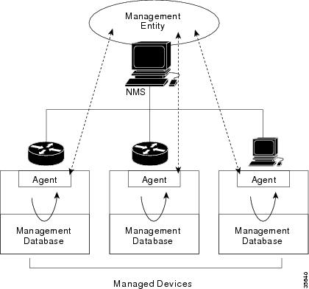
Nitte Meenakshi Institute Of Technology

Slide 7
Nitte Meenakshi Institute Of Technology
MODULES
Module 1: Client (TCP/IP)
Various remote users exists in the network
Client requests for status repeatedly
Receives status from the manager
Receives traps
Module 2: Manager (TCP/IP)
Constantly listens to the client
Sends message to the client

Slide 8
Module 3 : Manager (SNMP)
Nitte Meenakshi Institute Of Technology
Sends SNMP PDU's to the agent
Receives PDU's from the agent

Slide 9
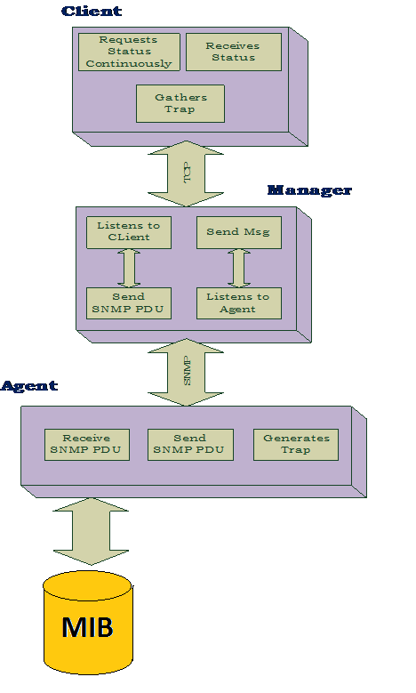
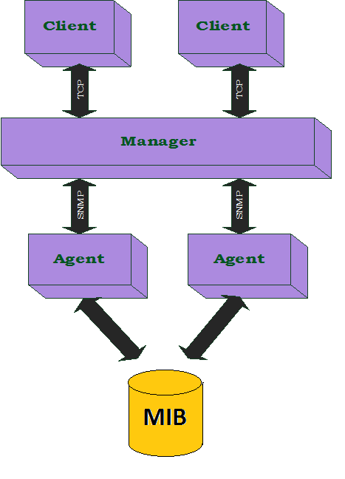
Nitte Meenakshi Institute Of Technology
HIGH LEVEL DESIGN
LOW LEVEL DESIGN

Slide 10
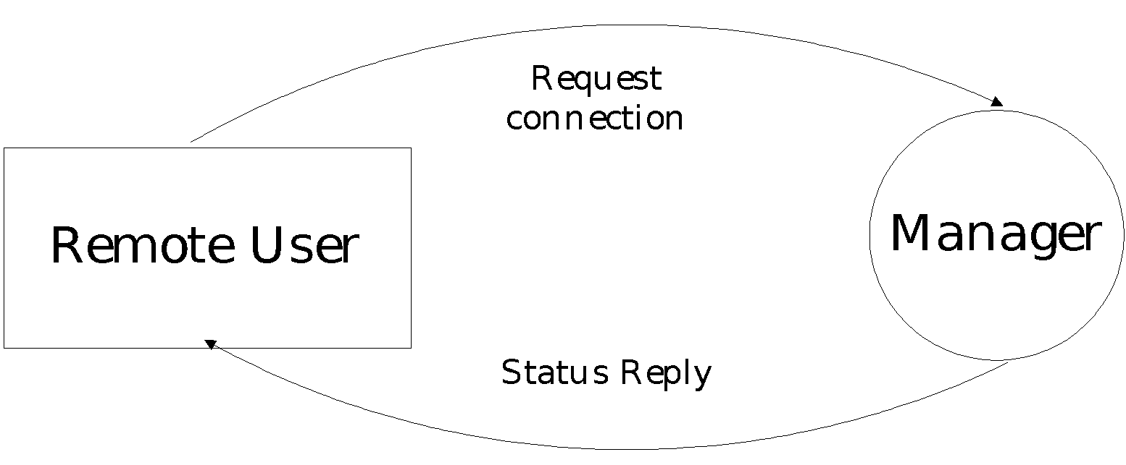
Nitte Meenakshi Institute Of Technology
DATA FLOW DIAGRAM
LEVEL 0

Slide 11
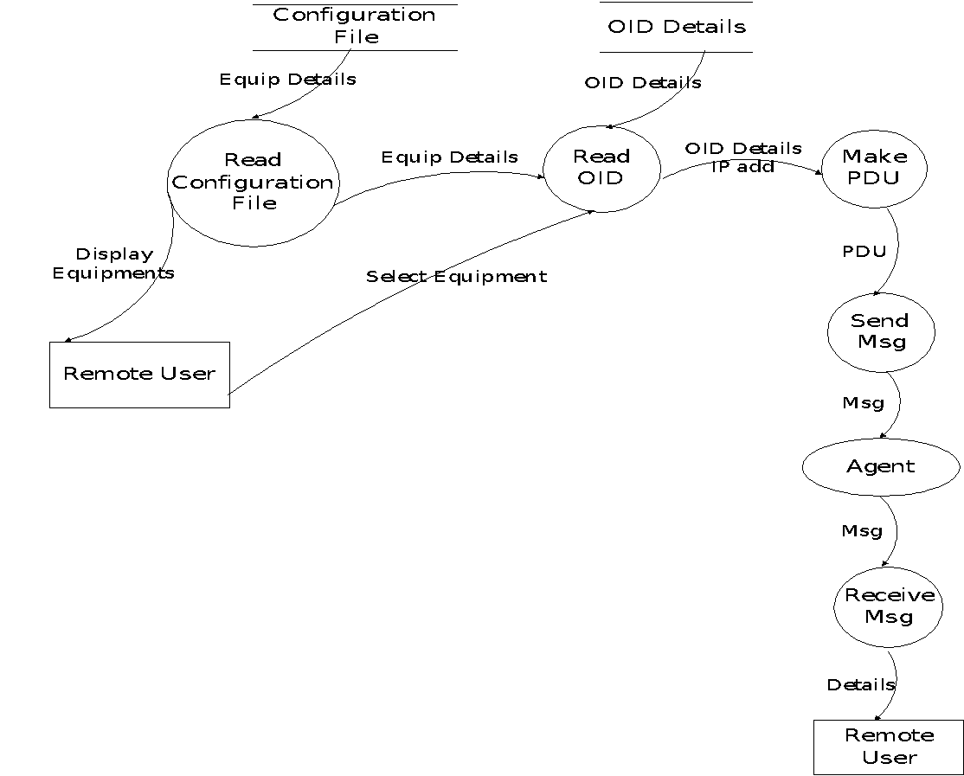
Nitte Meenakshi Institute Of Technology
LEVEL 1

Slide 12
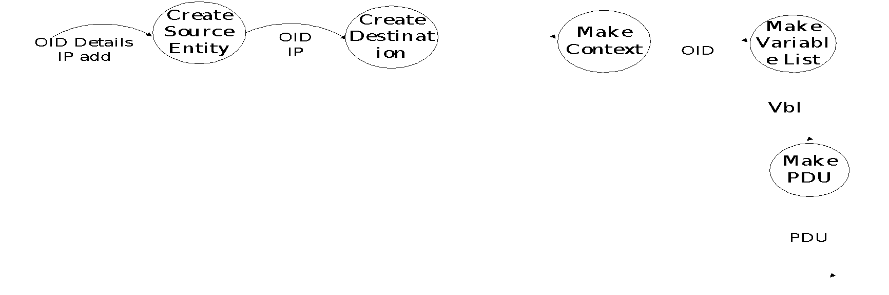
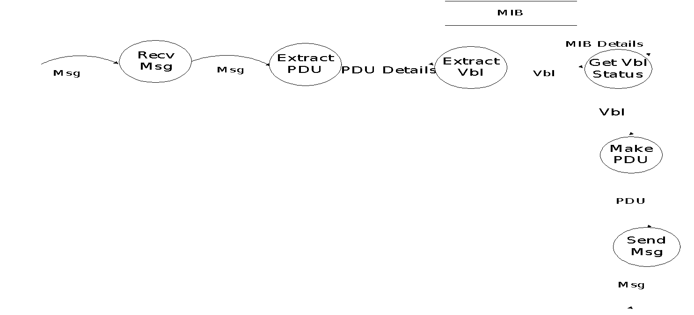
Nitte Meenakshi Institute Of Technology
LEVEL 2

Slide 13
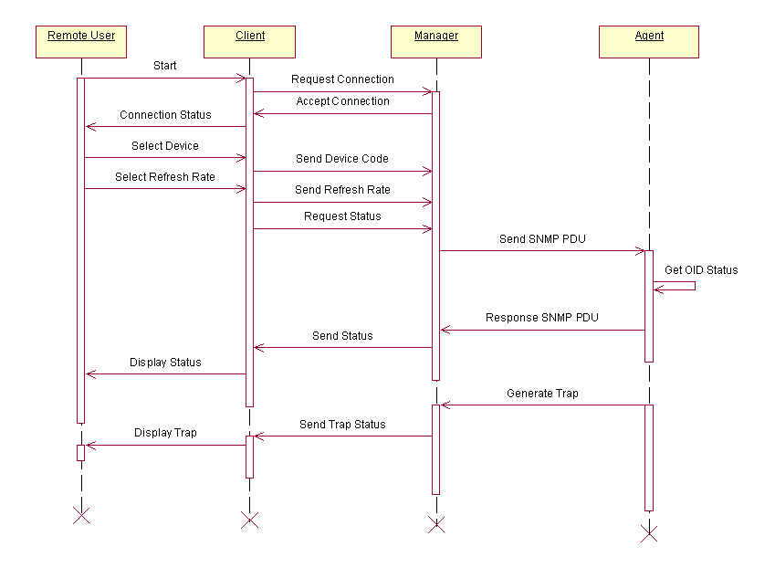
Nitte Meenakshi Institute Of Technology
SEQUENCE DIAGRAM GET & TRAP

Slide 14
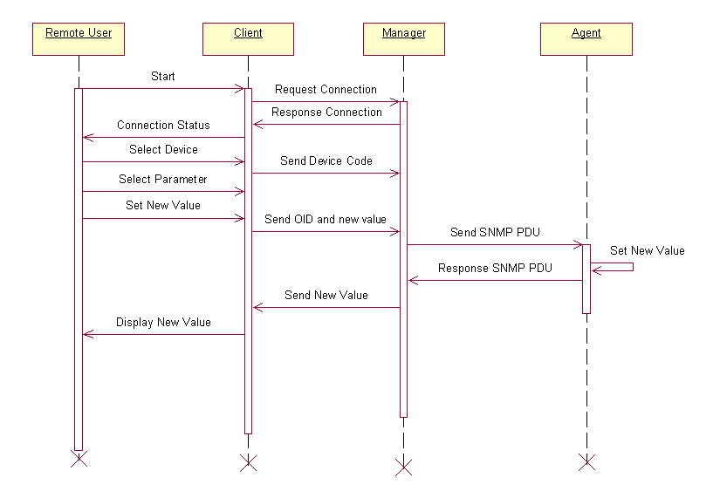
Nitte Meenakshi Institute Of Technology
SEQUENCE DIAGRAM SET

Slide 15
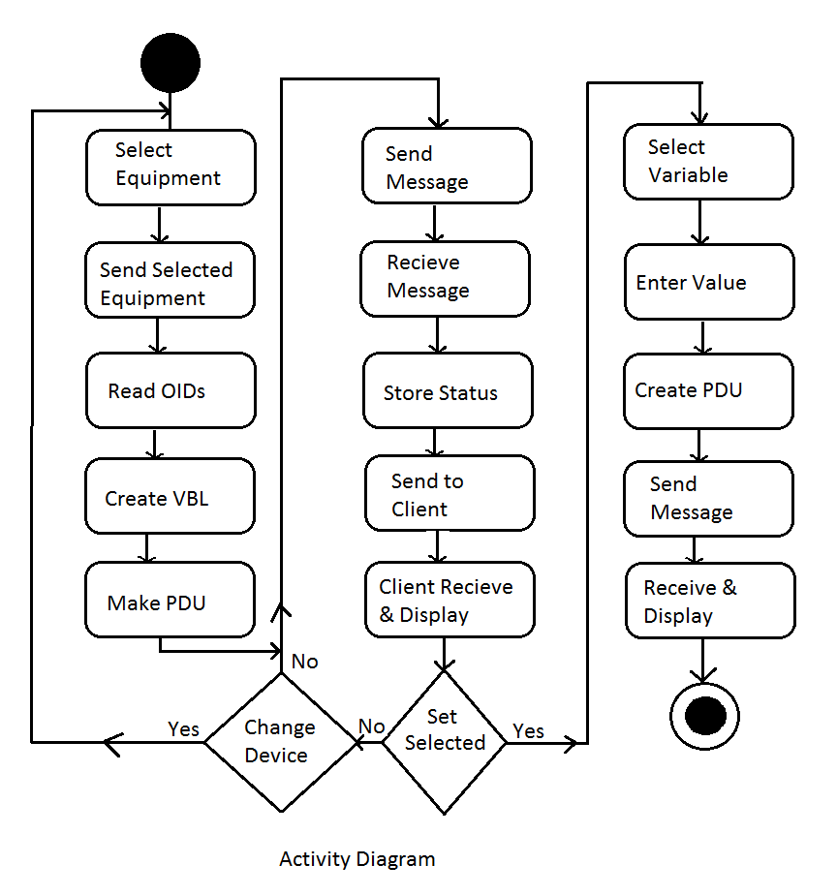
Nitte Meenakshi Institute Of Technology
ACTIVITY DIAGRAM

Slide 16
Nitte Meenakshi Institute Of Technology
FUNCTIONALITY
The system should monitor any device that supports SNMP
It should provide periodic updates of the health parameters of the configured equipments
User request to configure a parameter must be communicated to the equipment through the manager
Subsequent packet received must be reported
GUI implemented at the remote user end
System not responding & any error in the status must be reported; Every entry in the log must be time tagged

Slide 17
Nitte Meenakshi Institute Of Technology
USABILITY
User can select any equipment that is configured with the system
User can set rate for periodic update of the status, in terms of seconds
Any health parameter that has write access mode must be configurable
AVAILABILITY & RELIABILITY
The system should continuously monitor the given equipment
Runs on a 24/7/365 basis
Receipt of any traps must be notified by alarms

Slide 18
Nitte Meenakshi Institute Of Technology
PERFORMANCE
Response Time : users provide refresh rate for the response (in sec)
Throughput : system can send 32 OIDs /PDU
SECURITY
Usage of GUI at the remote user is authenticated
Parameters with read-write or write access mode available for configuration

Slide 19
Nitte Meenakshi Institute Of Technology
SYSTEM REQUIREMENTS
Microsoft Windows 2000 P4
3.00 GHz , Intel Xeon CPU
Ethernet Interface
1 GB RAM

Slide 20
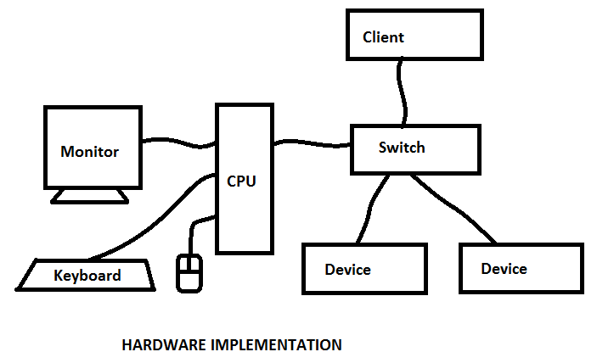
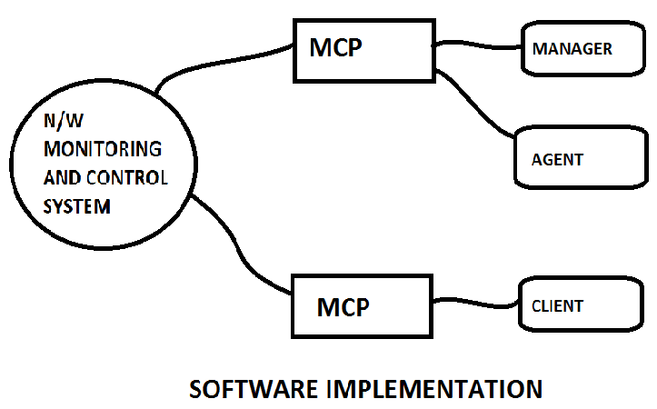
HARDWARE IMPLEMENTATION
Nitte Meenakshi Institute Of Technology
SOFTWARE IMPLEMENTATION

Slide 21
UNIT TESTING
Nitte Meenakshi Institute Of Technology
Reading INI files
Callback functions for UI Controls.
Get Request module at Manager
Set Request module at Manager
Trap Request module at Manager
Multiple Client connection
Communication with Client via TCP/IP
Displaying Received Messages on UI at the Client
Displaying Received Messages on UI at the Manager

Slide 22
INTEGRATION TESTING
Nitte Meenakshi Institute Of Technology
The modules which are to be integrated for the manager program are
Reading INI files
Callback functions for UI Controls.
Get Request module at Manager
Set Request module at Manager
The modules which are to be integrated for the Client program are
Displaying Received Messages on UI at the Client.
TCP/IP Manager Sender
TCP/IP Manager Receiver
Callback functions for UI Controls.

Slide 23
Nitte Meenakshi Institute Of Technology
FOLLOWING ARE THE TEST CASES WITH THE RESULT
Test Case ID
Test Case
Approach
Input
Output
Result
1
Periodic check of management data of the device.
Functional
Sending Set Request
Getting Response
Passed
2
Efficient communication with the agent.
Functional
Client connection and requests
Status display at Client
Passed
3
Display the status of all the data variables.
Functional
Response PDU
Display in UI
Passed
4
Display the trap messages from all devices.
Functional
Registering for Trap
Receiving Trap PDU
Passed
5
Should maintain multiple agents concurrently.
Functional
Many agents connection request
Status display on multiple agents
Passed
6
User should select any device at a given instance
Functional
Select device from UI
New status display in UI
Passed
7
Application has to alert the manager on any deviation of expected performance of device.
Functional
Receiving the trap Messages
Display of Trap messages in UI textbox
Passed
8
Product should be Scalable to add any number of equipments.
Functional
Connecting many devices
Devices names display in UI
Passed
9
Application has to alert the user of any network failure.
Functional
Disconnecting the Network
Application Disconnect
Passed
10
Allow the manager to control the equipments at any time.
Functional
Value to be Set
Set Response reply
Passed
11
Software should be available all the time.
Functional
Operating the application
24*7 operation
Passed
12
Subsequent packet received must be reported
Functional
Sending multiple PDU’s
Receiving response and display of all.
Passed
13
Health parameter that has write access mode must be configurable
Functional
INI file fields
Button activation for settable Vbl’s
Passed
14
User should be able to set the rate for periodic update of the status
Functional
Entering rate value in UI
Periodic update rate change
Passed

Slide 24
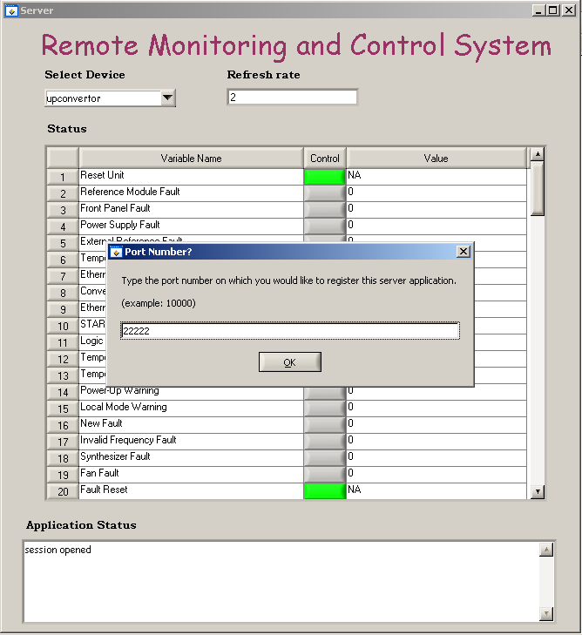
Nitte Meenakshi Institute Of Technology
Screen Shots
Server Initialization

Slide 25
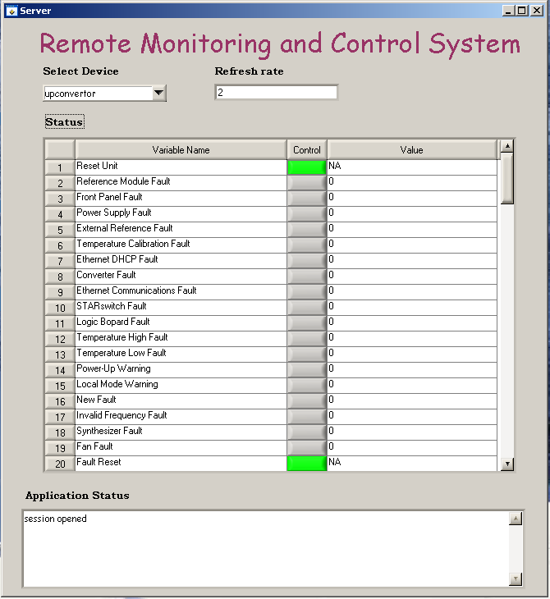
Server UI
Nitte Meenakshi Institute Of Technology

Slide 26
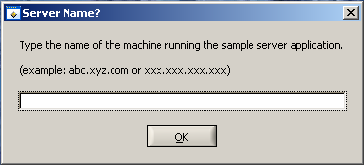
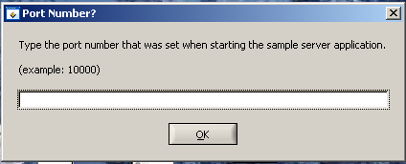
CLIENT INITIALIZATION WITH SEVER IP
Nitte Meenakshi Institute Of Technology
CLIENT INITIALIZATION WITH SEVER PORT NUMBER

Slide 27
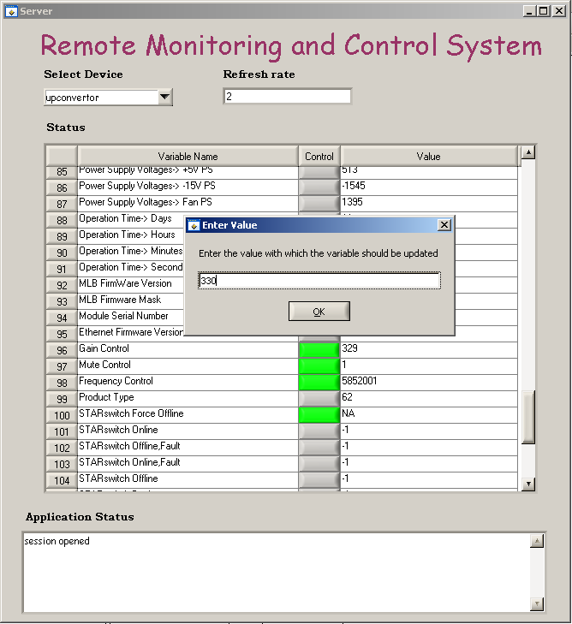
SET OPERATION AT SEVER
Nitte Meenakshi Institute Of Technology

Slide 28
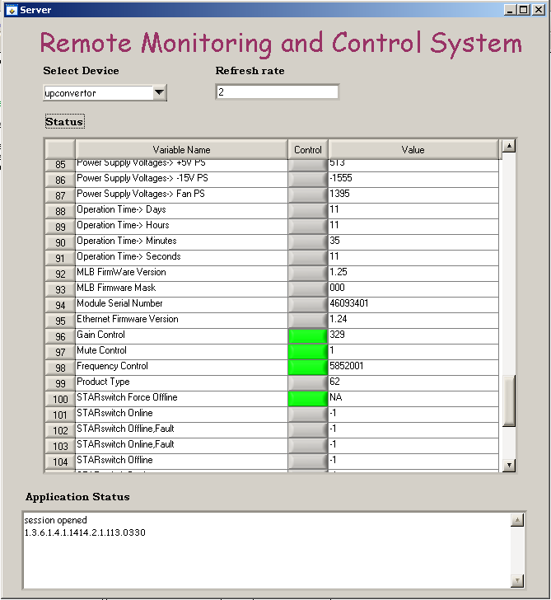
RESULT OF SET OPERATION AT SERVER
Nitte Meenakshi Institute Of Technology

Slide 29
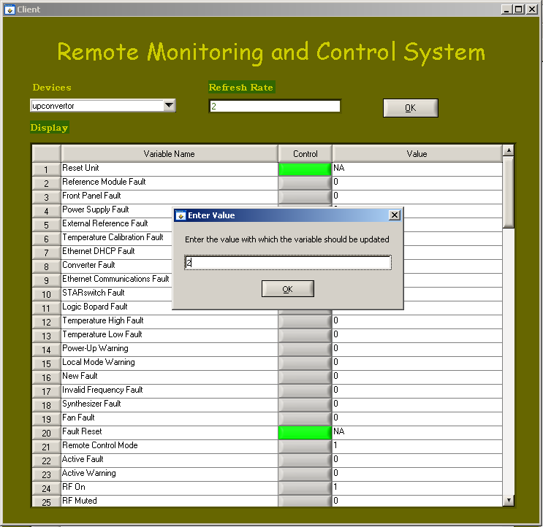
SET OPERATION AT CLIENT
Nitte Meenakshi Institute Of Technology

Slide 30
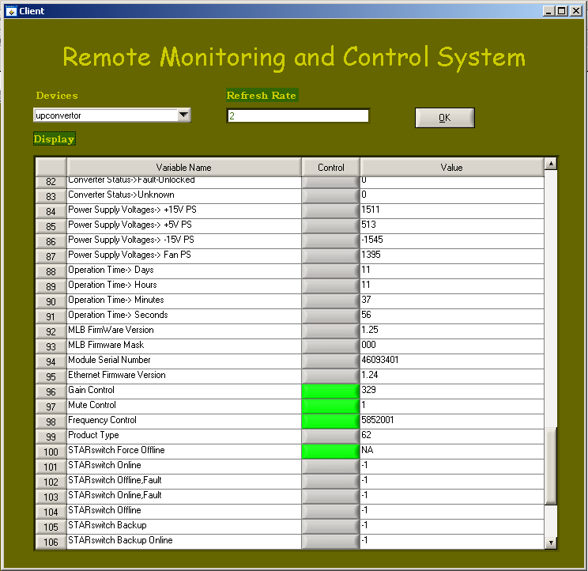
OUTPUT CLIENT UI
Nitte Meenakshi Institute Of Technology

Slide 31
Nitte Meenakshi Institute Of Technology
FUTURE ENHANCEMENT
This application of Remote Monitoring and Control System has been built for the monitoring of
any device that supports SNMP interfacing.
This application can be smartly enhanced to integrate all the interfacing protocols so that all
the ground station equipments can be monitored and controlled with the same software with
the interfacing protocol it supports.
This application can also be modified for the communication link monitoring between the
satellite and the ground station equipments.
Further the security of the application can be enhanced by authenticating the client connection
with the server.

Slide 32
Nitte Meenakshi Institute Of Technology
REFERENCES
BOOKS
Vertex RSI, Synthesized Converter System Operation and Maintenance Manual
Douglas, R., Mauro, Essential SNMP
Paul Simoneau, Hands on SNMP
IMPORTANT LINKS
http://www.cisco.com/univercd/cc/td/doc/product/iaabu/centri4/user/scf4ap1.htm
http://msdn.microsoft.com/enus/library/aa379100%28v=vs.85%29.aspx
www.ni.com/analysis/lwtools_analysis.htm

Slide 33
Nitte Meenakshi Institute Of Technology
CONCLUSION
Some of the latest equipments are supplied with SNMP protocol for its monitoring and control. This application is developed to provide monitoring and control support on SNMP interface for a given set of equipments. The application is built in such a way that any other equipment with SNMP interface could be integrated at any point of time. Building this interface enhanced existing monitoring and control system at ISTRAC by
Providing additional interface support
Adding any new equipment in future
Monitor communication link by monitoring routers, switches etc., that typically support SNMP for
monitoring, thus avoiding commercial Network Monitoring Systems.
4. Thus a new application has been built for interfacing with the SNMP supporting devices with
great flexibility so as to avoid commercial software packages thus contributing to organization
and the country.

Slide 34










Hebrew
Gracias
Grazie
Obrigado
Spanish
Russian
Italian
Portuguese
Thank You
Danke
German
Arabic
English
Merci
French
Thai
Traditional Chinese
Simplified Chinese
Korean
Japanese

